Slide 1

Object – Oriented Programming
Iksan Bukhori, M.Phil.

Slide 2
Topic 3: Classes and Objects
Most Materials in this slide are taken from a video by freecodecamp.org channel:
Object Oriented Programming with Python - Full Course for Beginners

Slide 3
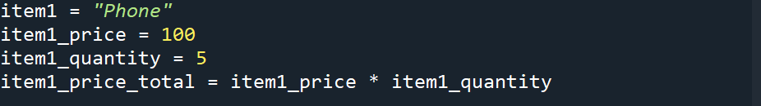
Taking a step back: Motivation to use OOP
Suppose that you want to create a program to store items which will be sold in your store
For example, you have a category of item called ‘Phone’ and you want to express variables defining the state of this item category in your store such as:
You may see that these four variables are related since they have similar names. However, for the interpreter, these four are four separate, distinct variables.

Slide 4
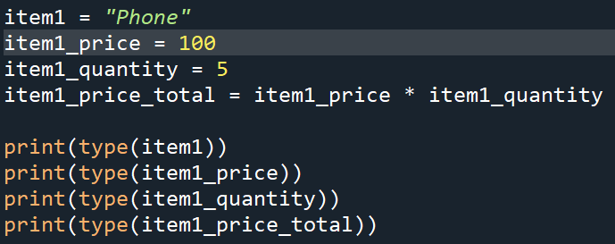
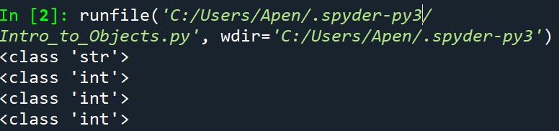
Data type as Instance of a class
If you print the data type for all of the four variables from before you obtain:
Data types are actually instances of the class of the same name (in the example above, str class and int class)

Slide 5

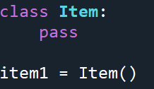
First Class Creation
Let’s create a class called ‘item’ from which later on we can instantiate the item objects (item1, item2, item3, and so on)
A very simple definition of such class is as follows:
We can then create instance item1 as

Slide 6
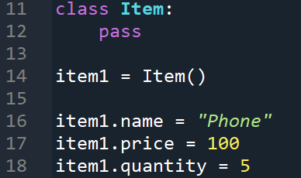
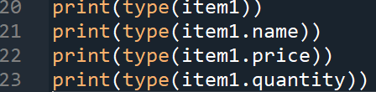
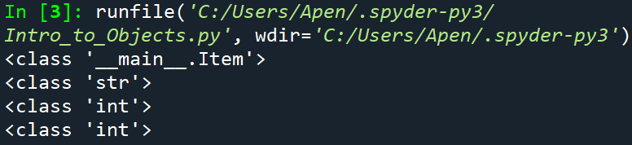
Assigning Attributes to Item Class
Let’s add some attributes to our class
Now as you can see we have relationship among the four attributes which we initially describe as some distinct variables
Let’s see the ‘data type’ of item1
Now the instance of this Item class is said to have data type ‘__main__.Item’ instead of ‘str’

Slide 7
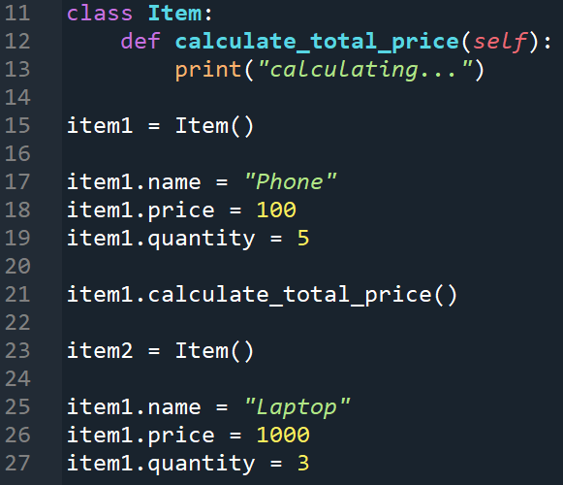
Adding methods to the class
Let’s add method ‘calculate_total_price’ to calculate total price
Line 12 is the method header
Pay attention to the ‘self’ parameter inside the method header. Every method needs to pass the object from which the method is called (represented by this variable ‘self’)
The method is called from item1 object (line 21)
Right now the method simply prints “calculating...”
Boring. Let’s make it more interesting

Slide 8
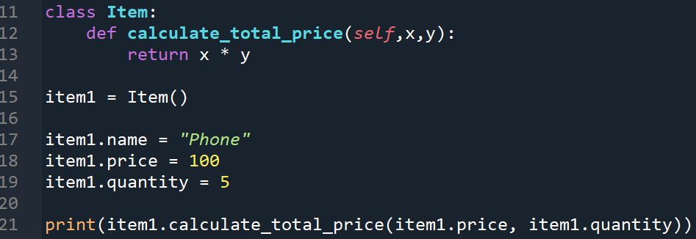
Adding more Parameters and return statement to Method
Let’s actually make the method we created to be able to calculate the total price of the item
For this we need to pass two arguments representing item quantity and item price when calling the method
Pay attention to how method header (line 12) is changed to have three parameters (including ‘self’)
Also pay attention to the return statement (line 13)
Also pay attention to how the method calling is changed in line 21

Slide 9
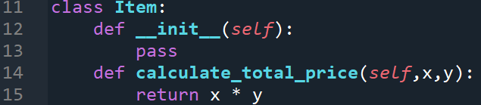
Adding Constructor to the class
Let’s add a mechanism to specify the attributes of the object when it is instantiated
To do that, we need to use constructor
Constructor is one of the special methods called magic methods in python. They are characterized by double underscore before and after the name of the method
The method name for the constructor is ‘init’ and should be defined as ‘__init__’ since it is one of the special method

Slide 10
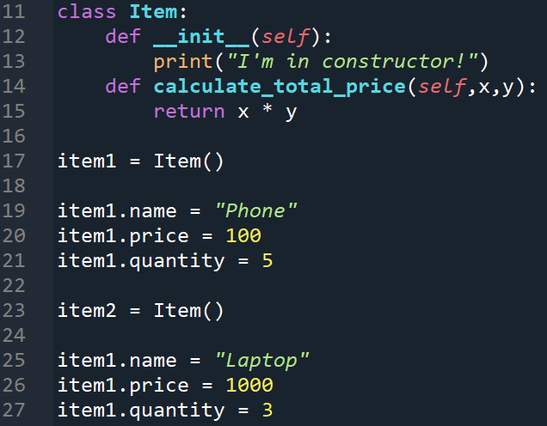
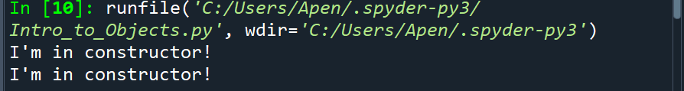
How constructor (__init__ method) works
Let’s try to print something inside the __init__ method
You should see the string “I’m in constructor!” being printed twice, since there are to instantiations of Item (line 17 and line 23)

Slide 11
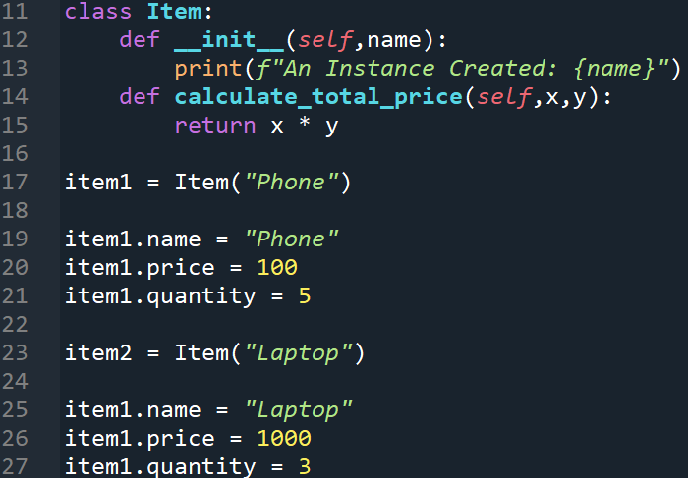
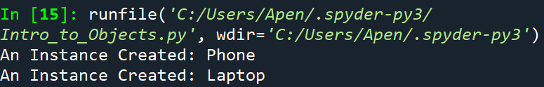
Passing Arguments to Constructor
Let’s include name attribute of the item object inside the instantiation process by passing it to the __init__()
Note: Line 13 is just another way to include expression (in this case variable) into string literal. This particular technique is called f-string or string interpolation
Please read the following website for more details on this technique and others
https://realpython.com/python-string-formatting/

Slide 12
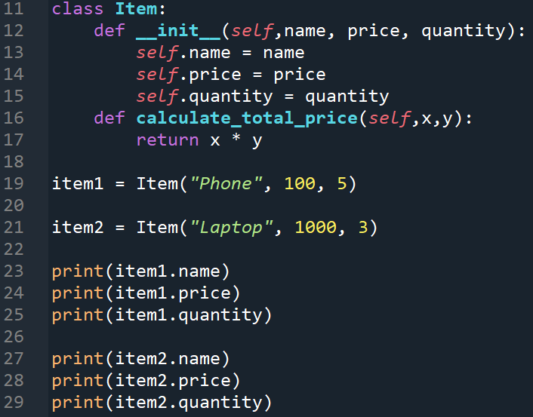
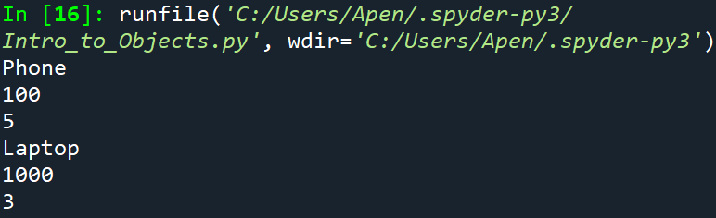
Assigning Attributes inside Constructor
Let’s assign all attributes inside constructor so that they are initialized every time the object is instantiated

Slide 13
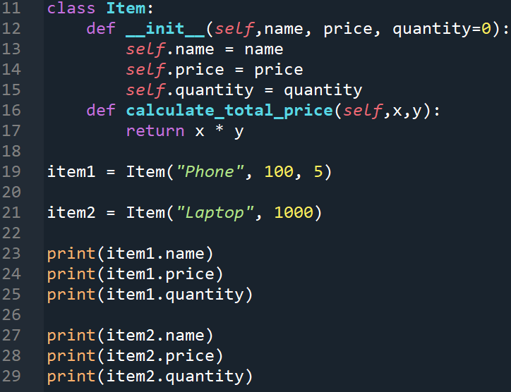
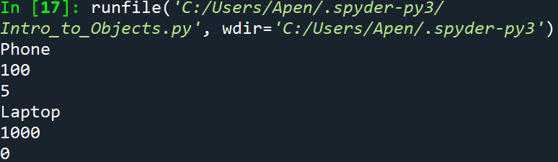
Including default value for parameters inside constructor
You can add default values for the parameters in constructor to handle the case when the object instantiation does not provide the required argument

Slide 14
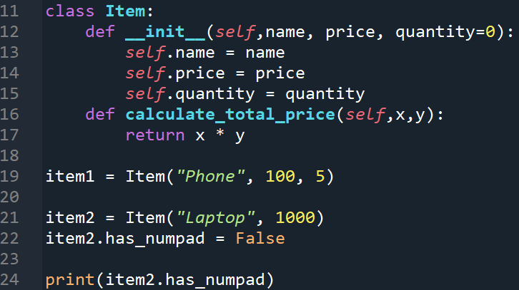

Adding certain attribute to a specific instance
In Python, you may add certain attributes which are not defined in constructor
This way, you can add attribute that belongs to certain objects (not all instances)

Slide 15
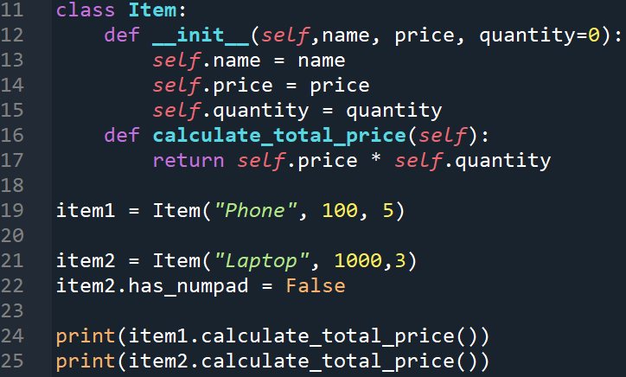
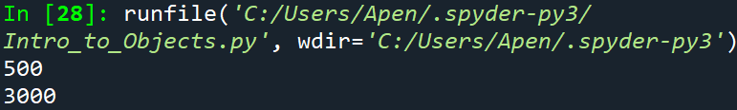
Fixing calculate_total_price method
Remember, when we call a method from a certain object, the object itself is passed to the method
Understanding this, we can simplify calculate_total_price()

Slide 16
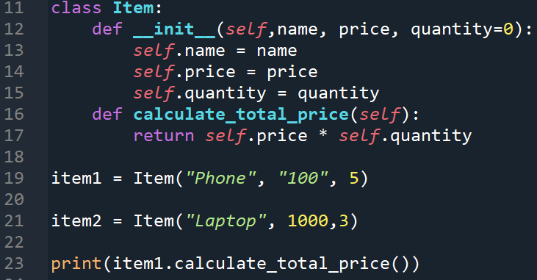

Next fixing: Validating Data type of passed arguments
What if we pass string instead of integers for ‘quantity’ arguments?
How do we control what data type should be used in argument?

Slide 17
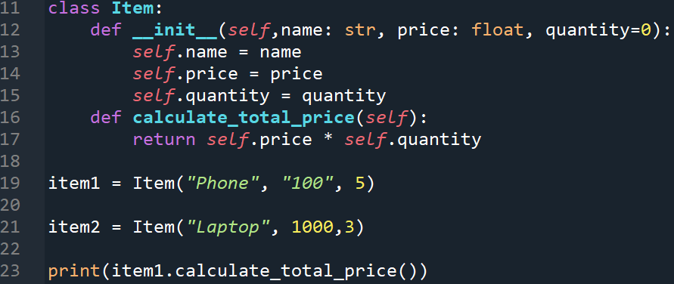
Controlling data type for the parameters
We can control what data type the arguments passed to a method by specifying the data type of the parameters for that method
Pay attention to how the quantity does not need to have the data type specified. This is because the default value already specify the data type it accepts

Slide 18
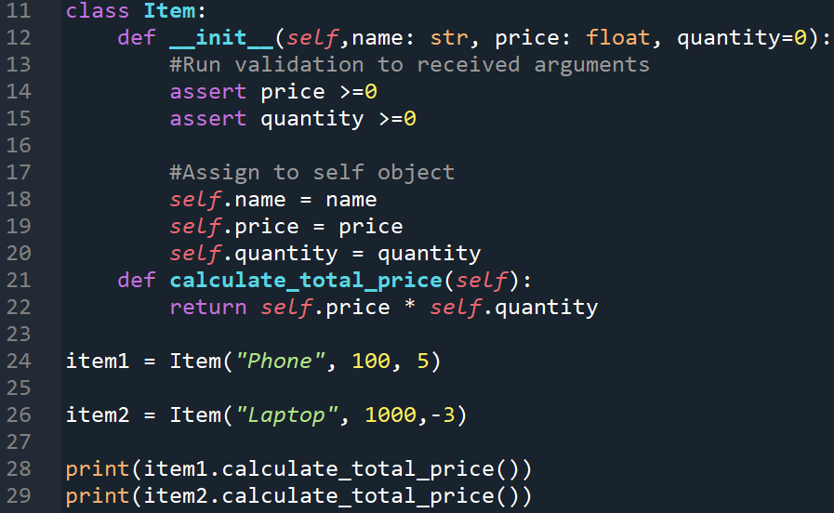
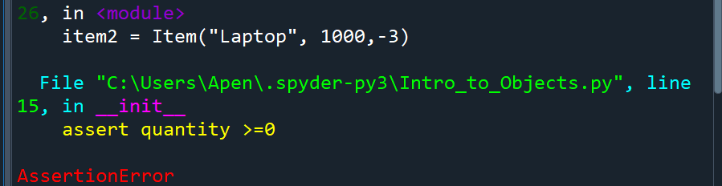
Next Fixing: Validating the possible values of the passed arguments
You can use assert statement to do this
Pay attention to how the ‘assert’ is called as statement, not function

Slide 19
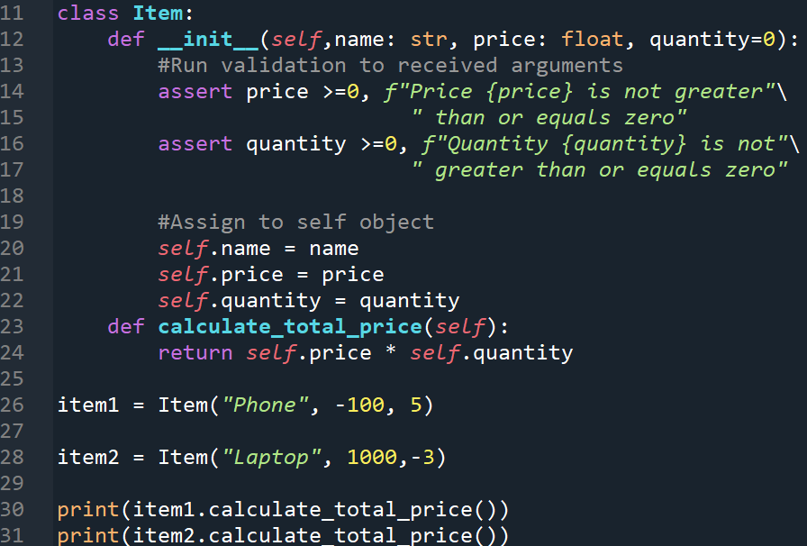
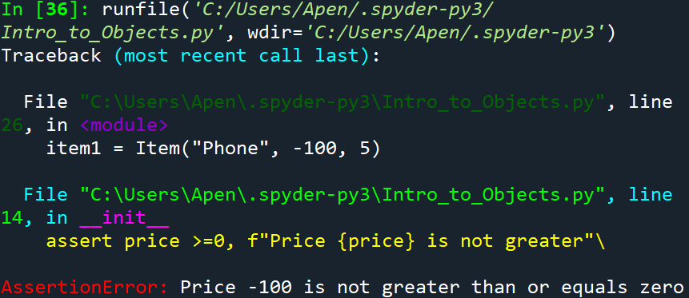
Adding Custom message to Assertion
You can simply add message as string as second argument for assert statement

Slide 20
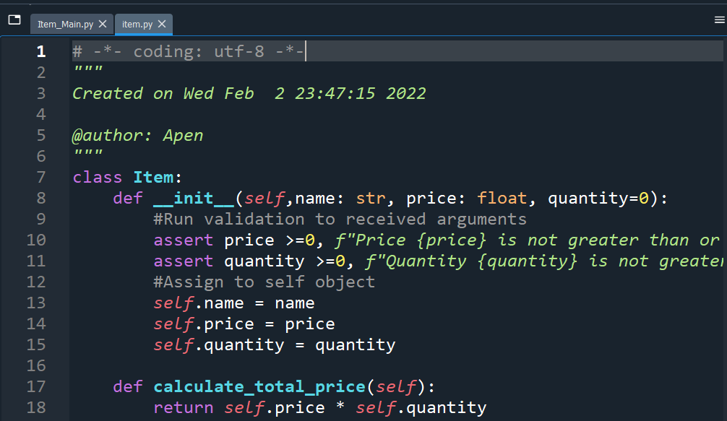
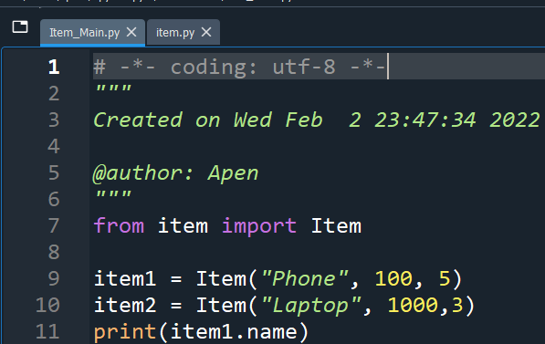
Separating Item Class from Main
You can now save the code describing the item class into an individual file, for example item.py
Then you can create another py file as the main file to access Item class
In this file, you of course would need to import Item class from item.py

Slide 21
Exercise: Let’s make Number Guessing Game
Computer needs to select a random integer
Ask user to guess the number
If the user guess too high, print(“Your guess is too high. Try again.”) and give the user another chance
If the user guess too low, print(“Your guess is too low. Try again.”) and give the user another chance
Loops until the user guessed correctly and print(“Congratulation. You guess correctly.”)

Slide 22
Exercise: Let’s make a Hangman Game
Basic rules of the game:
Computer chooses a word randomly from a list of words
Computers prints dashes (-) according to the number of the letter of the word
Player guesses one letter at a time, if he/she guesses correctly, replace the dash at the appropriate position with the letter
Player wins if he/she can guess all of the letters

Slide 23
Hangman Game: Let’s think about what we need
A list of words for computer to choose from randomly
A set to store all the letters contained in the chosen word
A variable to store the letter given by the user
A set to store the letters that have been used/guessed by the user
A list to store the current progress of a game (showing correctly guessed letters along with dashes for the still-hidden letters)
etc. (We’ll add more if we need)

Slide 24
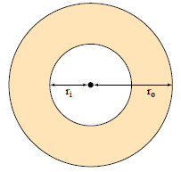
Homework 2
Make an Object-Oriented Program to calculate the area, circumference, and diagonal length of a rectangle given (by user) the length of the two sides
Write a program that computes the area of a circular region (the shaded area in the diagram), given the radii of the inner and the outer circles, r_{i} and r_{o}, respectively. Define a Circle class that has methods to compute the area and circumference. Setet the circle’s radius via a constructor

